Slide 1
Seafood on a Budget: how EU consumers are adjusting to reduced purchasing power
EUMOFA Talk
5 July 2023
Notes:
Concept note
- Shrinking disposable income – cost of living crisis influencing purchasing decisions
- The investigation will delve into the evolution of consumer behaviour in response to financial contraction.
- Luxury divisions within this milieu will be examined, exploring their resilience against income contraction and the resulting impact on the broader market
- consider the various ways in which consumer behaviour adaptations can influence the trajectory of the fisheries and aquaculture sector in terms of economic viability, environmental impact, and long-term sustainability.

Slide 2
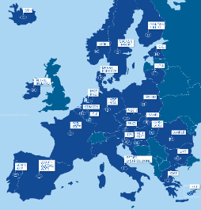
Who we are, what we do
We stand for:
Fair, competitive & sustainable retail and wholesale in Europe.
through
1 in 4 companies in the EU are SME retailers and wholesalers
We provide work to 26 million Europeans - 1 in 7 of all jobs
Retail and Wholesale represents 10% of the EU’s GDP

Slide 3
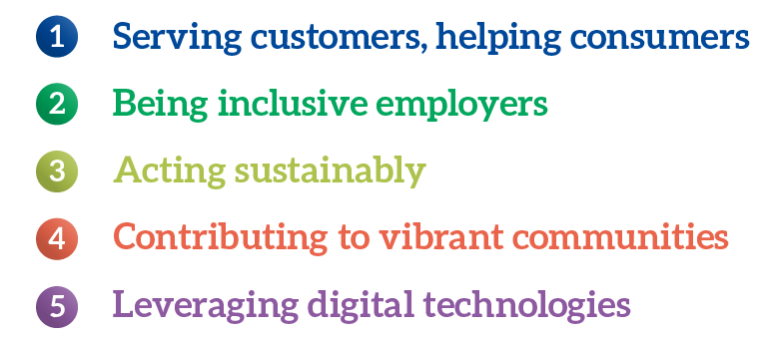
About our sector
Fair, competitive and sustainable retail & wholesale
Acting Sustainably
Retailers care for the planet
Retailers help customers to make healthy choices
Retailers value cooperation with suppliers

Slide 4
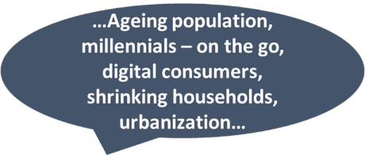
EU Consumers
Changing patterns of consumption

Slide 5
Transforming the EU retail and wholesale sector
Christel
Sustainability · Digitalization · Skills
Report summary
Describe required transformation and quantify likely investment needs until 2030 for EU retailers and wholesalers across sustainability, digitalization, and skills and talent, to build resilience and secure a growth path, ultimately benefitting companies, consumers, suppliers, and the overall EU economy
Collaboration between

Slide 6
The Triple Transformation
Franck
Additional investments¹ required till 2030 in EUR and as share of sector’s total revenues, p.a.
Sustainability
Digitalization
Skills and talent
€ 135-335 bn
€ 155-230 bn
€ 25-35 bn
€ 315-600 bn
0.4-0.6%
~0.1%
4.4-5.2%
0.3-0.9%
+0.8-1.6pp
3.6%
Today’s investment level²
Required investment level
1. Cumulative 2023-2030, definition of additional investments detailed in report 2. Includes total capital expenditures and IT operating expenditures for EU retailers and wholesalers
Source: McKinsey analysis
McKinsey & Company
6
Notes:
- retailers and wholesalers may need to invest up to an additional 1.6% of sector’s revenues per year

Slide 7
State of Grocery – annual reports

Slide 8
State of Grocery Retail 2021 Disruption & Uncertainty
Online sales ↑↑ significantly (+55%) in 2020 - this trend will continue
Consumers trading up or down due to the economic effects of the pandemic;
37% of consumers looked to saving money;
50% of consumers planned to buy more healthy, local or environmentally-friendly foods in 2021;
26% of consumers wanted both to save money on groceries & move towards sustainable lifestyles.

Slide 9
Sustainability concerns vary by demographic and product category
*Exhibit 3, Disruption and Uncertainty – The State of Grocery Retail 2021

Slide 10
Eurobarometer 2021
EU Consumer habits fishery & aquaculture products
What are the most important aspects when buying fishery and aquaculture products?
Notes:
Most important factor (58%): the product’s appearance (e.g freshness, presentation)
Cost of the product (54%) // Origin of the product (48%) //Brand or quality labels (26%)
How easy and quick it is to prepare (24)

Slide 11
State of Grocery Retail Navigating the market headwinds (2022)
Russian invasion of Ukraine and consequences of sanctions → inflationary pressure and reduction of consumers’ available income
Widening polarization with higher price sensitivity and more focus on health, premium, and sustainability at the same time.
Notes:
The Russian invasion of Ukraine unleashed massive challenges in the food supply chain beyond spiralling energy costs
Consumer survey
Countries :
CEO’s

Slide 12
B: Widening polarization (1/2)
More details in speaker notes
2021
2022
Big yoy change
Net intent¹ of customers towards grocery shopping in 2022 compared to 2021, in %, European average
Price
Intention to look for more ways to save money in 2022 than 2021
Health
Intention to focus more on healthy eating/nutrition in 2022 than 2021
Quality
Intention to buy more high quality/premium food products in 2022 than 2021
Environment
Intention to pay a higher price to get an environmental-friendlier product in 2022 than 2021
52%
Higher price sensitivity and increasing demand for products related to health, premium and sustainability at the same time
40%
39%
32%
35%
28%
27%
29%
20%
15%
-7%
-9%
Low income
High income
Low income
High income
Low income
High income
Low income
High income
Share of consumer that want to do more of activity minus share of consumer that want to do less of activity in 2022 vs. 2021) Thus, negative numbers imply that consumers want to reduce their grocery shopping in these categories.
Source: Consumer Survey, 11/06-11/30, N=11’573 incl. the following markets: CH, DE, ES, FR, IT, NL, PL, SE, UK, sample to match general population 18+ years
12
Notes:
Speaker notes
For price, quality, and environment the net intent gap between low- and high-income groups is >20 p.p.
Compared to 2021, the net intent gap for price and health between low- and high-income groups increased clearly (+8 p.p. and +2 p.p.)

Slide 13
B: Widening polarization (2/2)
56%
of consumers plan to look for ways to save money
29%
of consumer plan to do both
48%
of consumers plan to focus on healthy eating and nutrition
29% of consumers want both, save money on groceries while focusing more on healthy eating and nutrition
Question: Think about 2022. Are you planning to do more, less or about the same of the following? Note: Only consumers who intend to do more of those activities are shown on this page
Source: Consumer Survey, 11/06-11/30, N=11’573 incl. the following markets: CH, DE, ES, FR, IT, NL, PL, SE, UK
13
Notes:
Question: Think about 2022. Are you planning to do more, less or about the same of the following? Note: Only consumers who intend to do more of those activities are shown on this page
Source: Consumer Survey, 11/06-11/30, N=11’573 incl. the following markets: CH, DE, ES, FR, IT, NL, PL, SE, UK

Slide 14
State of Grocery Retail Living with and responding to uncertainty (2023)
Difficult economic climate
Inflationary pressure continues and consumers’ downtrading
53% plan to save more money on food
polarisation between higher- and lower-income groups decreasing
Consumer behaviour in 2023 expected to continue to reflect a cautious approach
Notes:
The Russian invasion of Ukraine unleashed massive challenges in the food supply chain beyond spiralling energy costs
→ inflationary pressure and reduction of consumers’ available income as all segments become more price-sensitive due to increasing costs of living.
resulting from the knock-on effects of the economic uncertainty

Slide 15
2022 brought us…
Retail sales index, EU 27
Covid 19
Inflation
Surging inflation
Volumes going down
Consumer downtrading:
cheaper alternatives
more private label
discounters
Intense pressure on grocer’s margins
Retail sales 100 = 2014
15
Source: State of Grocery Retail 2023 (Mckinsey & Eurocommerce)
Source: Statista & calculations by Eurocommerce

Slide 16
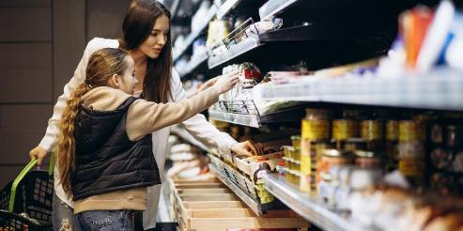
Retail amidst high inflation
Retail sales in 2022 grew by 2.9% only because of inflation
Retail sales volumes have decreased since 2022 as consumers change their shopping habits to make ends meet.
-4.9%
Volume of food retail trade in February 2023 vs February 2022
Source: Europanel, EuroCommerce & McKinsey, Eurostat

Slide 17
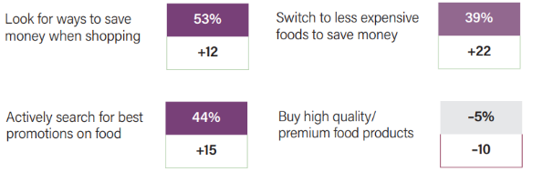
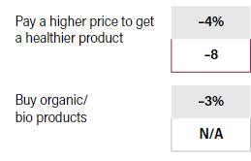
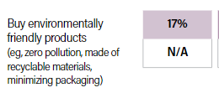
Consumers in a cost-of-living crisis
Consumers have downtraded when shopping
+1.9%
Increase of share of private label across Europe in 2022
Consumers are reducing purchases of fresh products (meat, fish, fruit and vegetables) and organic food to buy more pasta, rice and canned products.
Consumers prefer shopping at supermarkets and discounters to find better deals and purchase more private label products than branded goods.
Amidst a cost-of-living crisis, consumers:
+1.4%
Increase of market share by discounters
Source: EuroCommerce & McKinsey, Eurostat

Slide 18
Price sensitivity of high and low income groups converging
Attitude towards grocery shopping in 2023 compared to 2022, Net intent of consumers, %
2022
2023
Price
Intention to look for more ways to save money
Quality
Intention to buy high quality / premium products
Health
Intention to focus more on healthy eating
+ 3 p.p.
+ 18 p.p.
- 16 p.p.
- 5 p.p.
- 2 p.p.
55%
20%
52%
39%
50%
37%
29%
32%
4%
24%
- 9 p.p.
-7%
-16%
Low income
High Income
Low income
High Income
Low income
High Income
18
Source: State of Grocery Retail 2023 (Mckinsey & Eurocommerce) Consumer Survey, N=10 727, UK, DE, FR, IT, ES, NL, CH, PL, SE, sample to match general population 18+ years
Notes:
1. Q: Think about 2023. Are you planning to do more, less or about the same of the following? I plan to...
The percentage is calculated as net intent (% of people intending to do activity more - % of people intending to do activity less). Sample sizes for Low- and High-income consumers in total are 2.2 and 4.6 thousand respondents, respectively
Retail & wholesale
All product categories of retail & wholesale sector hit hard by inflation crisis
Margin pressure and downtrading by far the biggest challenges in 2023 for grocery retail CEO’s
Downtrading happening not only in products, but also in shop formats
Private label products & hard discounters rise in importance in grocery landscape
High-income consumers suddenly almost as price-sensitive as low-income groups
Health is strongest remaining argument for premium pricing in groceries

Slide 19
Consumers spend less on groceries
Attitude towards grocery shopping Net intent of consumers (yes – no)
Price
Switch to less expensive food to save money
Quality
Intent to buy high-quality / premium food
Private label
Intent to buy more private label
+ 22 p.p.
+ 22 p.p.
— 10 p.p.
2022
2023
2022
2022
2023
2023
19
Source: State of Grocery Retail 2023 (Mckinsey & Eurocommerce) Consumer Survey, N=10 727, UK, DE, FR, IT, ES, NL, CH, PL, SE, sample to match general population 18+ years
Notes:
1. Q: Think about 2023. Are you planning to do more, less or about the same of the following? I plan to...
The percentage is calculated as net intent (% of people intending to do activity more - % of people intending to do activity less). Sample sizes for Low- and High-income consumers in total are 2.2 and 4.6 thousand respondents, respectively

Slide 20
We expect retail food prices to decline staring H2 2023
Producer & Retail prices grow despite Agri price decline
Food value chain prices dynamics index, 2019 = 100
Agricultural prices started growing
Producer prices and Retail Prices react to Agri prices
Agricultural Price Index
Producer Price Index
Retail Price Index
10 months
4 months
2019
2020
2021
2022
20
Source: State of Grocery Retail 2023 (Mckinsey & Eurocommerce), Eurostat, Refinitiv, World Bank, FAO
Notes:
Typical lag between unprocessed food prices and retail prices of several months up to a year, as price evolutions (both upward and downward) need time to work themselves through the food value chain. This is because of contracts that don’t have real-time pricing and second round inflation effects like wages being adjusted to inflation

Slide 21
Italy

Slide 22
The shopping basket in 2022
Source: ISMEA

Slide 23
The organic shopping basket in 2022
Source: ISMEA

Slide 24
France

Slide 25
France Focus on fresh food in hypermarkets and supermarkets
Source: IRI (hypermarkets, supermarkets, e-commerce
Notes:
The sales of fresh food products (= unpacked products) decreased by -2,8% in value during the first 8 months of 2022 compared to the same period in 2021. fresh fruit and vegetables by -2.6%, in line with the general trends. You can see that it is the least hit category, contrary to meat and especially seafood.

Slide 26
France Inflation: food
Source: INSEE
Notes:
INSEE: L’Institut national de la statistique et des études économiques collecte, produit, analyse et diffuse des informations sur l’économie et la société françaises

Slide 27
Inflation
Source : INSEE - dernière donnée avril 2023

Slide 28
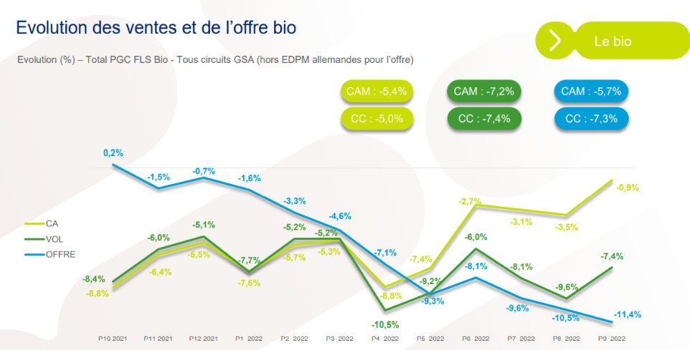
France Organic market (all products)
Notes:
The organic products market in France has been on the decline for several months. During the first 9 months of the year, sales in supermarkets have decreased by 5% in value compared to the first 9 months of 2021. They had fallen by 3.1% in 2021 and increased by 13% in 2020.

Slide 29
France: Consumer attitudes towards meat in cost-of-living crisis
Source: Elabe May 2023

Slide 30
Spain

Slide 31
consumption in 2022 (1)
Sales of meat decreased by 12,8% in volume in 2022 compared to 2021 and by 6,3% in value.
Source : MAPA

Slide 32
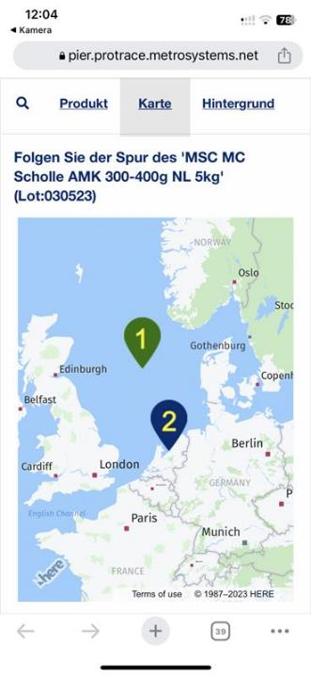
Besides price…..
Quality, information and transparency

Slide 33
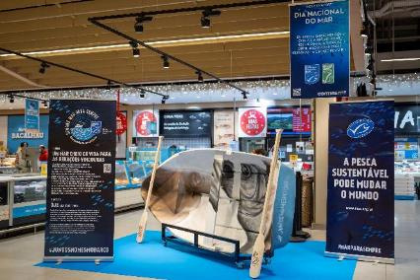
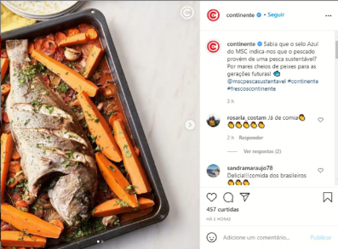
Besides price….
Quality, information and transparency

Slide 34
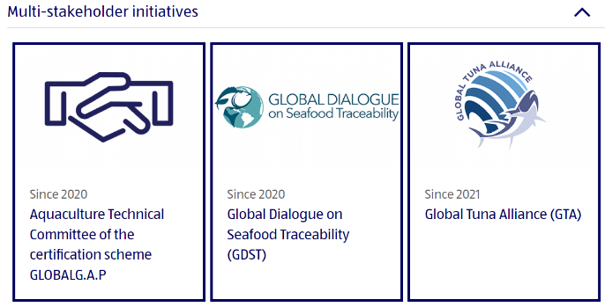
Besides price….
Quality, information and transparency

Slide 35
Besides price….
Quality, information and transparency

Slide 36
EuroCommerce: take-home messages
All product categories of retail & wholesale sector hit hard by inflation crisis
Downtrading happening not only in products, but also in shop formats
Private label products & hard discounters rise in importance in grocery landscape
High-income consumers suddenly almost as price-sensitive as low-income groups
Health is strongest remaining argument for premium pricing in groceries
Margin pressure and downtrading by far the biggest challenges in 2023 for grocery retail CEO’s
Retailers and wholesalers continue wide range of voluntary initiatives to help consumers make informed choices
Education - The effect of any label or action would be substantial if it is accompanied with awareness and communication campaigns.

Slide 37
Thank you

