Slide 1
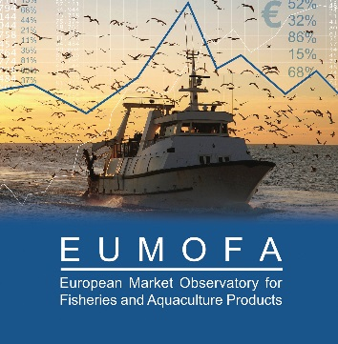
Groundfish supply trends -
Challenges and opportunities
EUMOFA market analyst: Jan Erik Øksenvåg
Conxemar – October 2, 2024

Slide 2
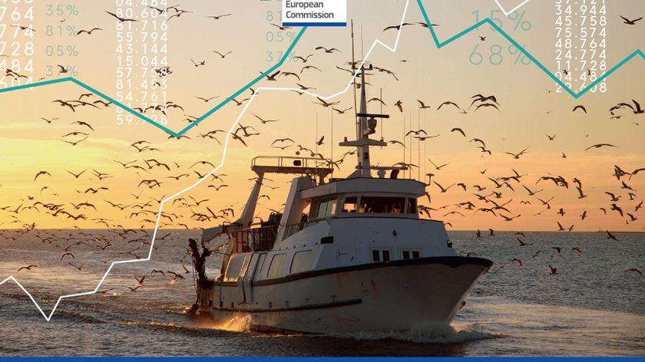
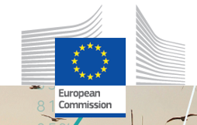
MEETING AGENDA

Slide 3
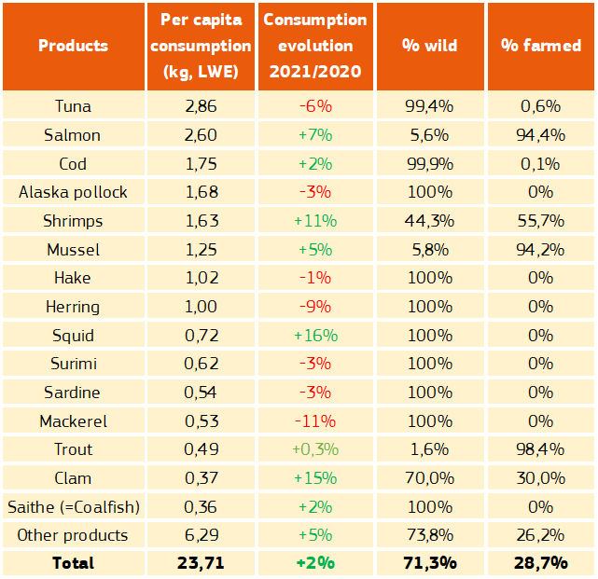
Most consumed species in the EU
…….cod, Alaska pollock and hake among to top 7 species

Slide 4
Consumption trend groundfish

Slide 5
EU groundfish landings
Cod, haddock, hake, ling, pollack, redfishes, whiting, other groundfish

Slide 6
Market prices

Slide 7
EU groundfish imports
Alaska pollock, cod, haddock, hake, ling, pollack, redfishes, whiting, other groundfish

Slide 8
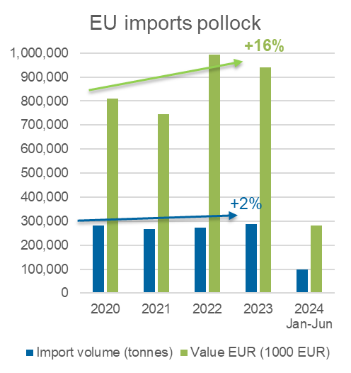
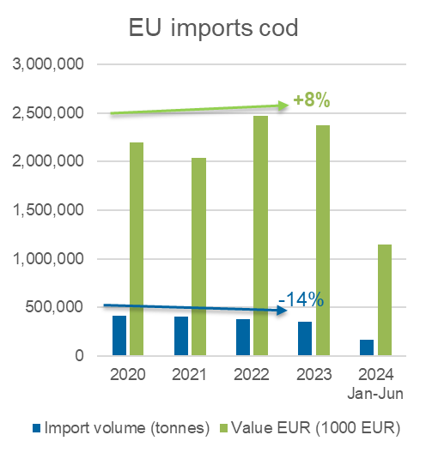
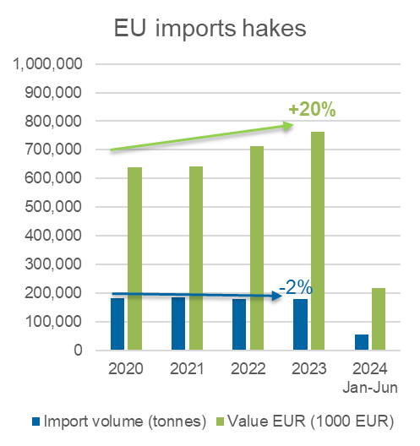
EU groundfish imports

Slide 9
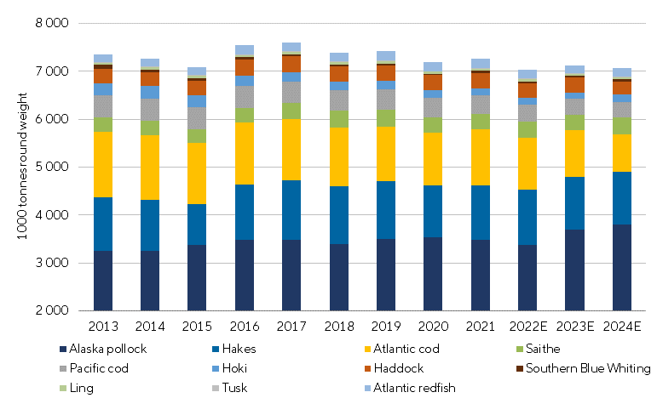
Global groundfish overview

Slide 10
Prices trends for groundfish products to end consumer
The consumer
Still strong focus on sustainable sourcing but price become more important (taken increased cost of living into consideration).
Downtrading to cheaper FAP alternatives
Or switching to other proteins..

Slide 11
The consumer

Slide 12
Summary
Lower groundfish quotas and fishing opportunities negative for most fleet segments – rise in first sale prices helps fishers and vessel owners but not necessarily processors
While Atlantic cod stocks are low, other ground fish stocks are healthier (Alaska pollock, hake, haddock, saithe)
Could open opportunities for farmed products (bass/bream, cod, meagre, tilapia and catfish)
After a period of steep rise in fish prices – how will demand for groundfish develop.

Slide 13
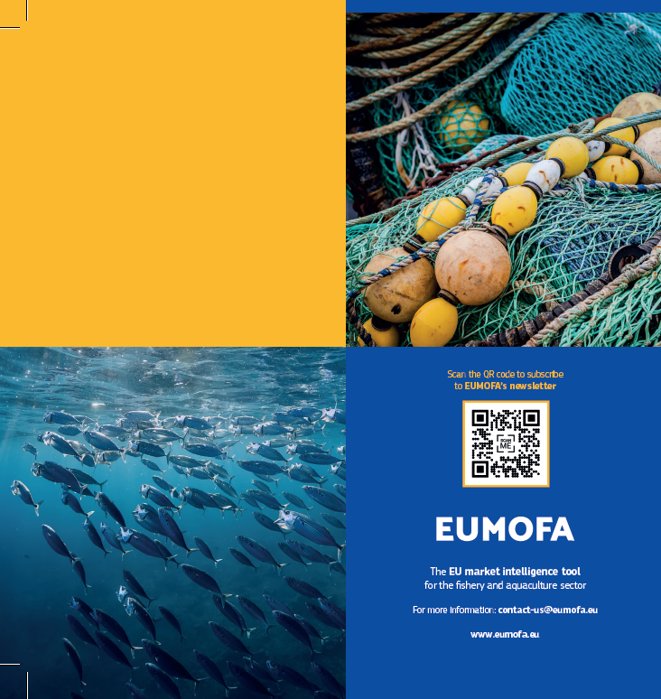
Thank you for
your attention!
www.eumofa.eu
contact-us@eumofa.eu
EU Maritime & Fish
@EU_MARE

